Slide 1
GAME DEVELOPMENT SUBMITTED BY: PREETI KURMI

Slide 2
Assessment Instructions Task 1: Research and Documentation CONTENT: ~Game scene events in Gdevelop ~ Player movement and uploading your own assets (walk, run, jump, idle) ~Animation in Gdevelop ~Adding dialogue in Gdevelop ~Adding sound effects gameplay-wise ~Importing assets and creating scenes ~Making the player look in both directions

Slide 3
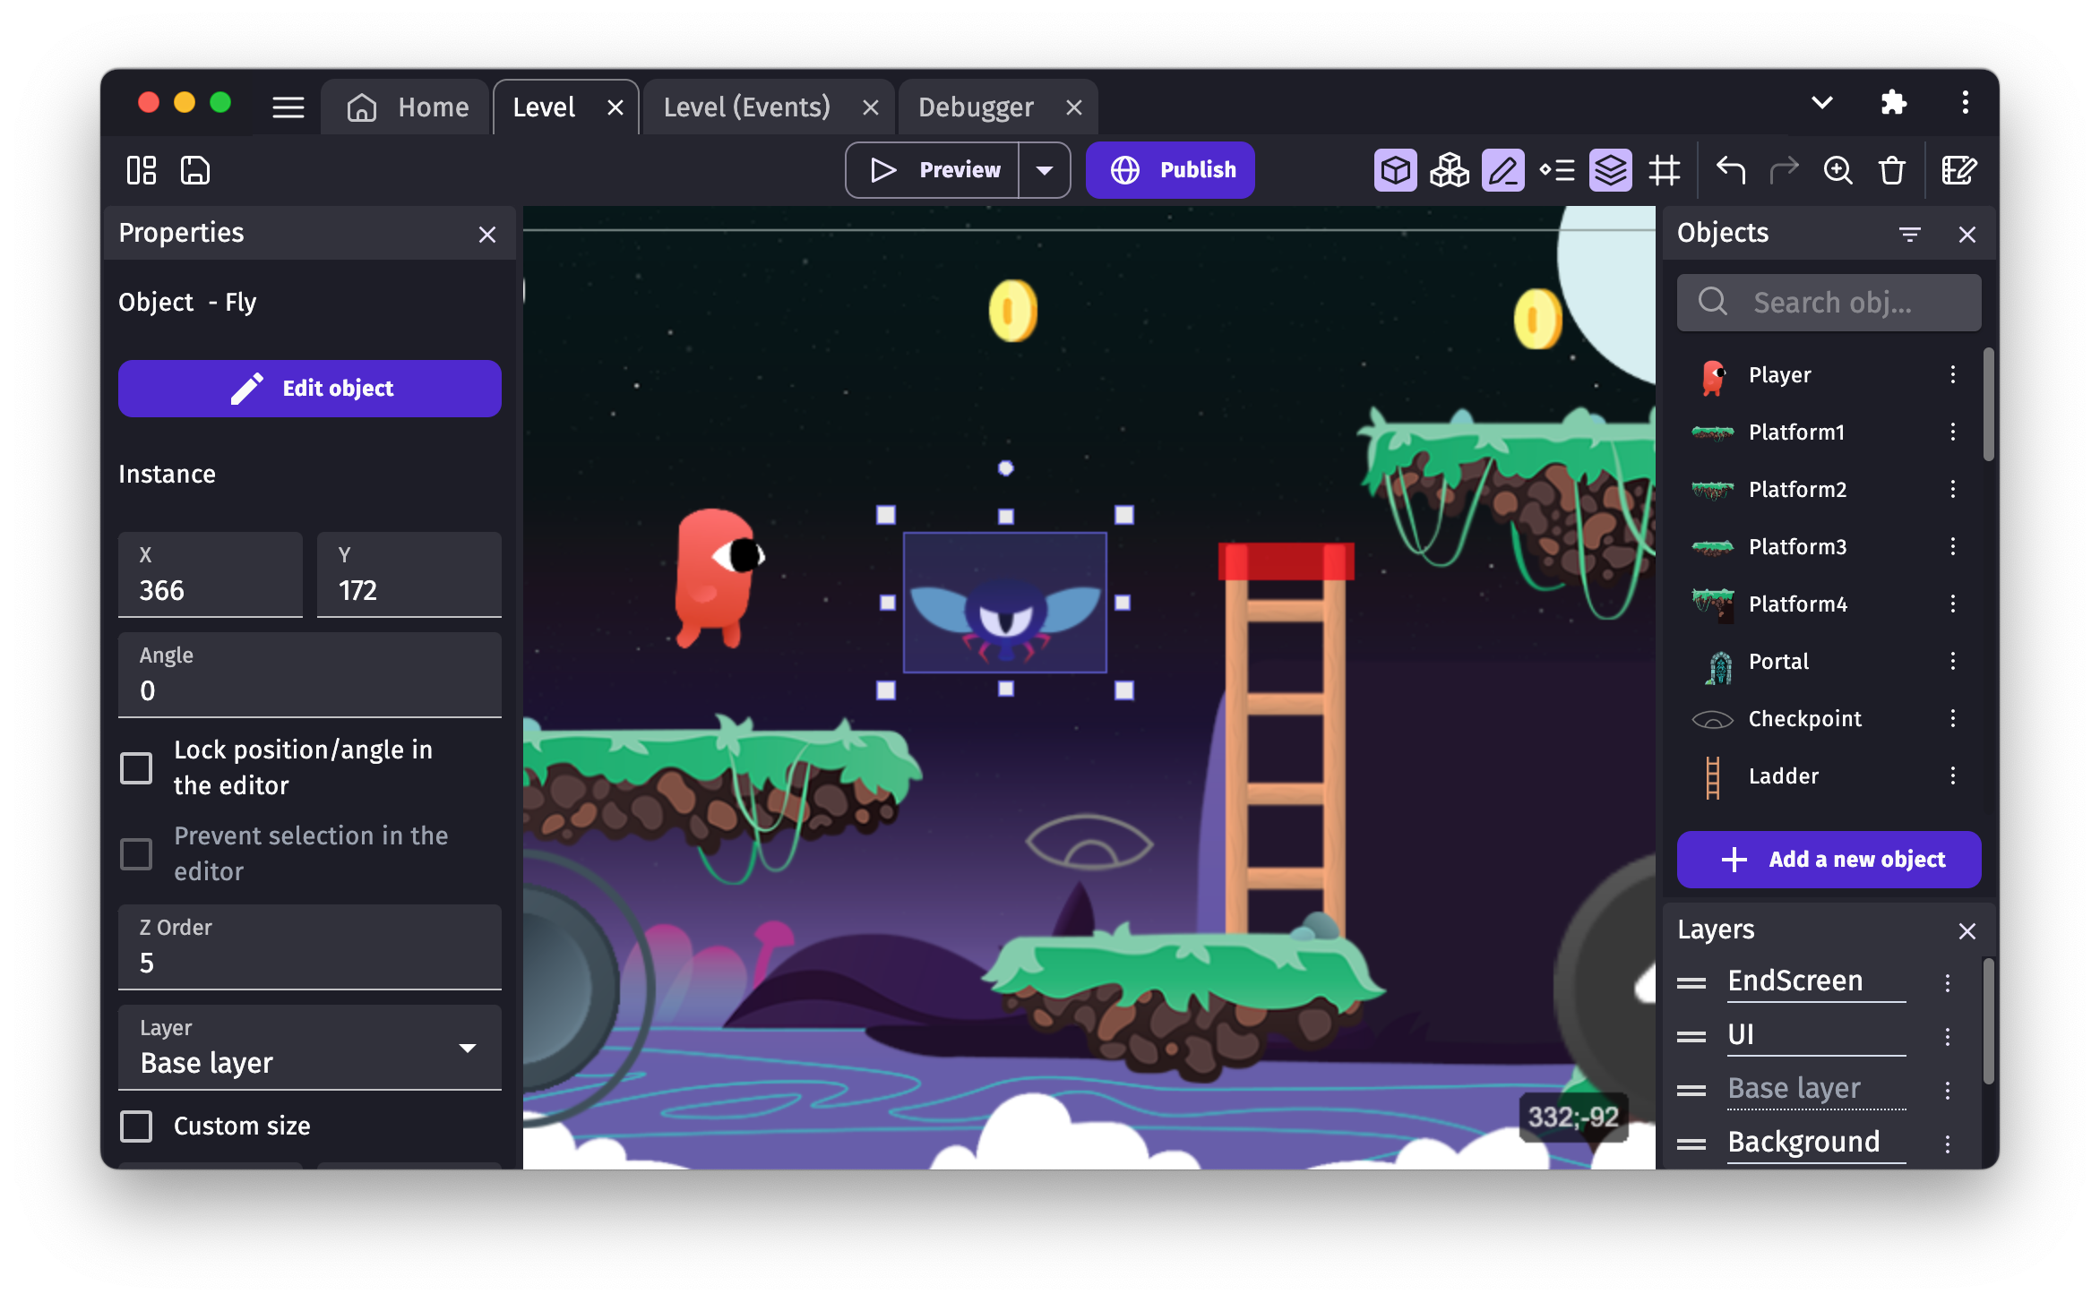
GDEVELOP
G Develop is a free, open-source, and cross-platform game creation tool that anyone can use to create games without programming skills. This documentation contains everything you need to know to create games with GDevelop — even if you've never created a game before. It's known for its user-friendly interface and drag-and-drop event system, making it accessible to both beginners and experienced developers. It is designed specifically for creating 2D games.

Slide 4
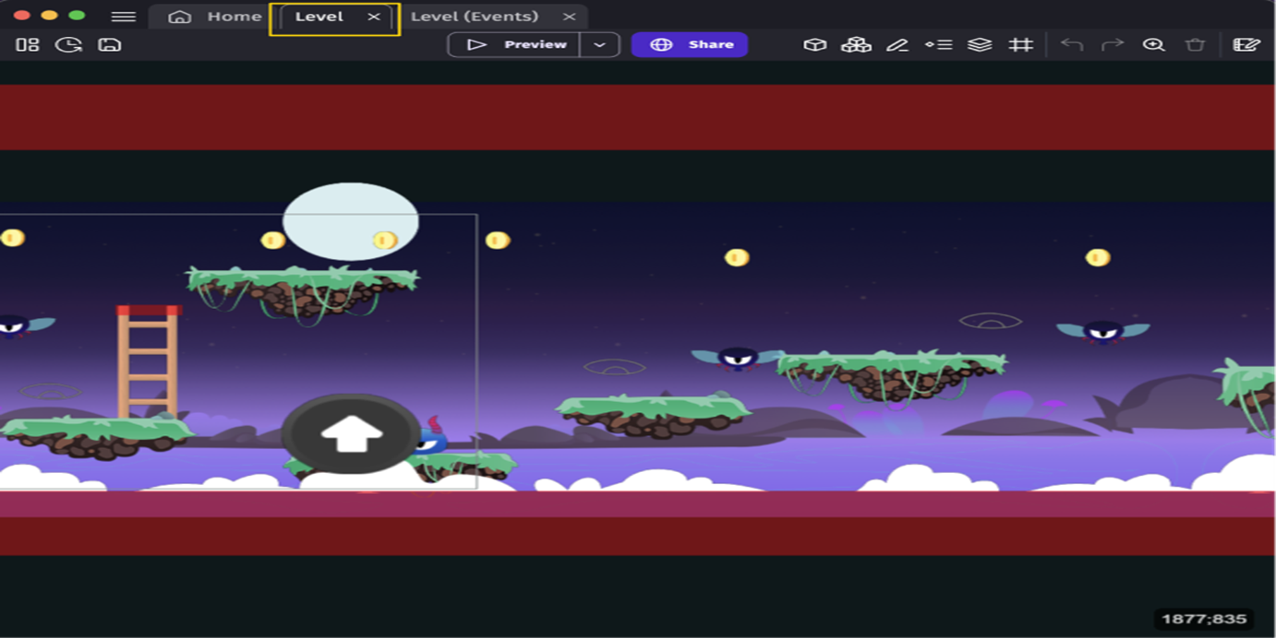
Game scene events in G develop
In GDevelop, game scene events are the building blocks that define the logic of your game. Events in GDevelop follow a simple condition-action model:
Conditions are the requirements that must be met for the event to occur.
Actions are what happen when the conditions are fulfilled
When opening a scene (or an external layout), the Scene Editor opens.

Slide 5
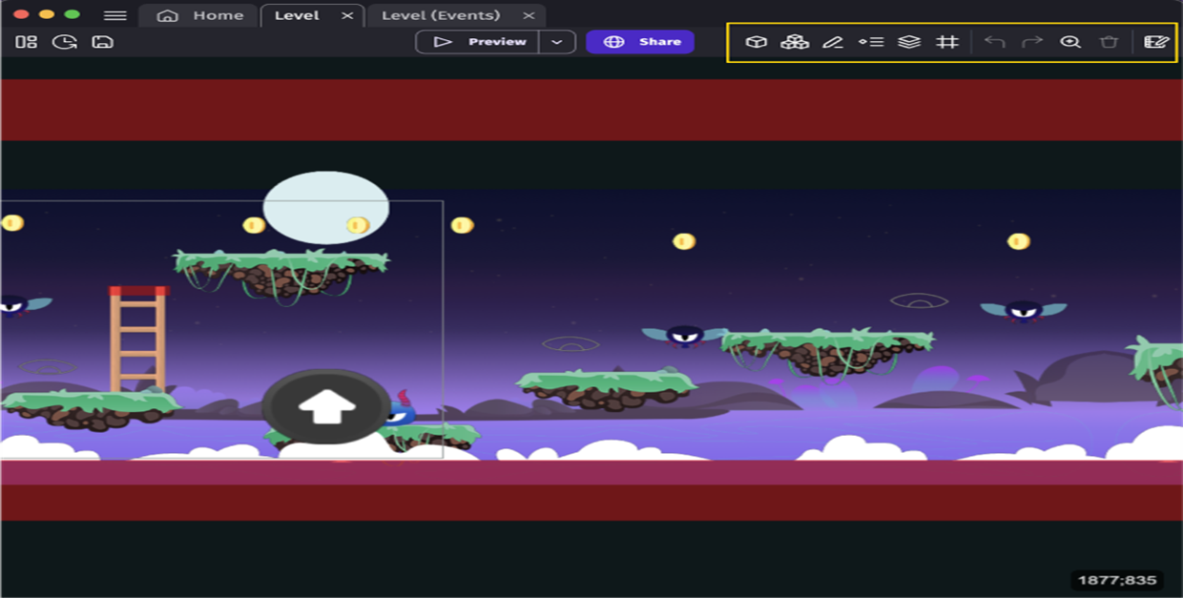
The Scene Editor is where you can design and build the game levels, menus, inventories, or any other screen in the game. The Scene Editor allows you to create and add objects to the scene. The gameplay and rules of the game can be created using events in the Events Editor.
On the right side of the toolbar in the scene editor, you have options to open panels used for different parts of your game, as well as some other tools.

Slide 6
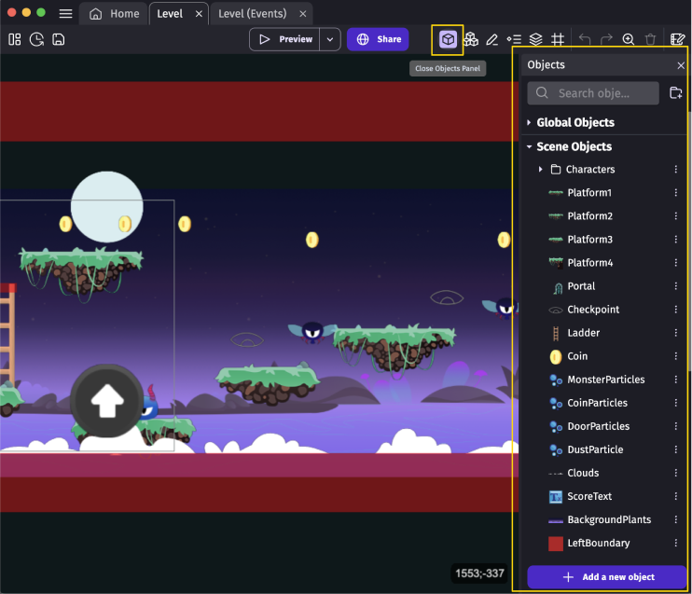
Objects panel
The Objects Panel, when first opened, appears on the right side of the Scene Editor's interface. This is where you can see all of the objects used in your scene. You can also add new objects to your list by clicking the add new objects button at the bottom of the panel.

Slide 7
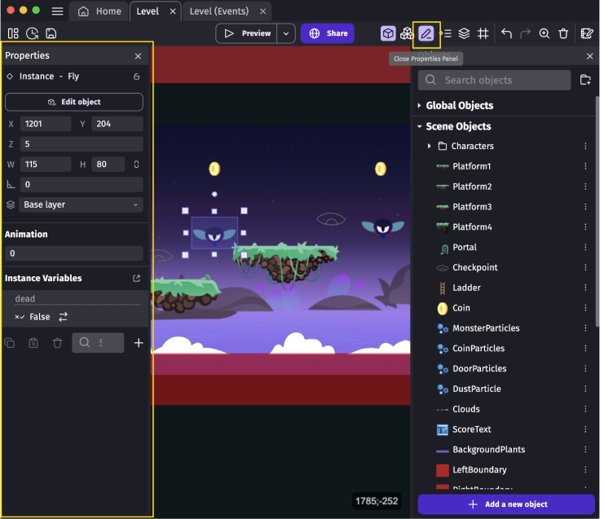
Instance Properties panel
You can find the Instance Properties panel on the left side of the Scene Editor's interface. When opened, the panel may have no information displayed in it, but if you select an instance of an object placed into your scene, the panel will display all of the information relevant to that instance of the object.

Slide 8
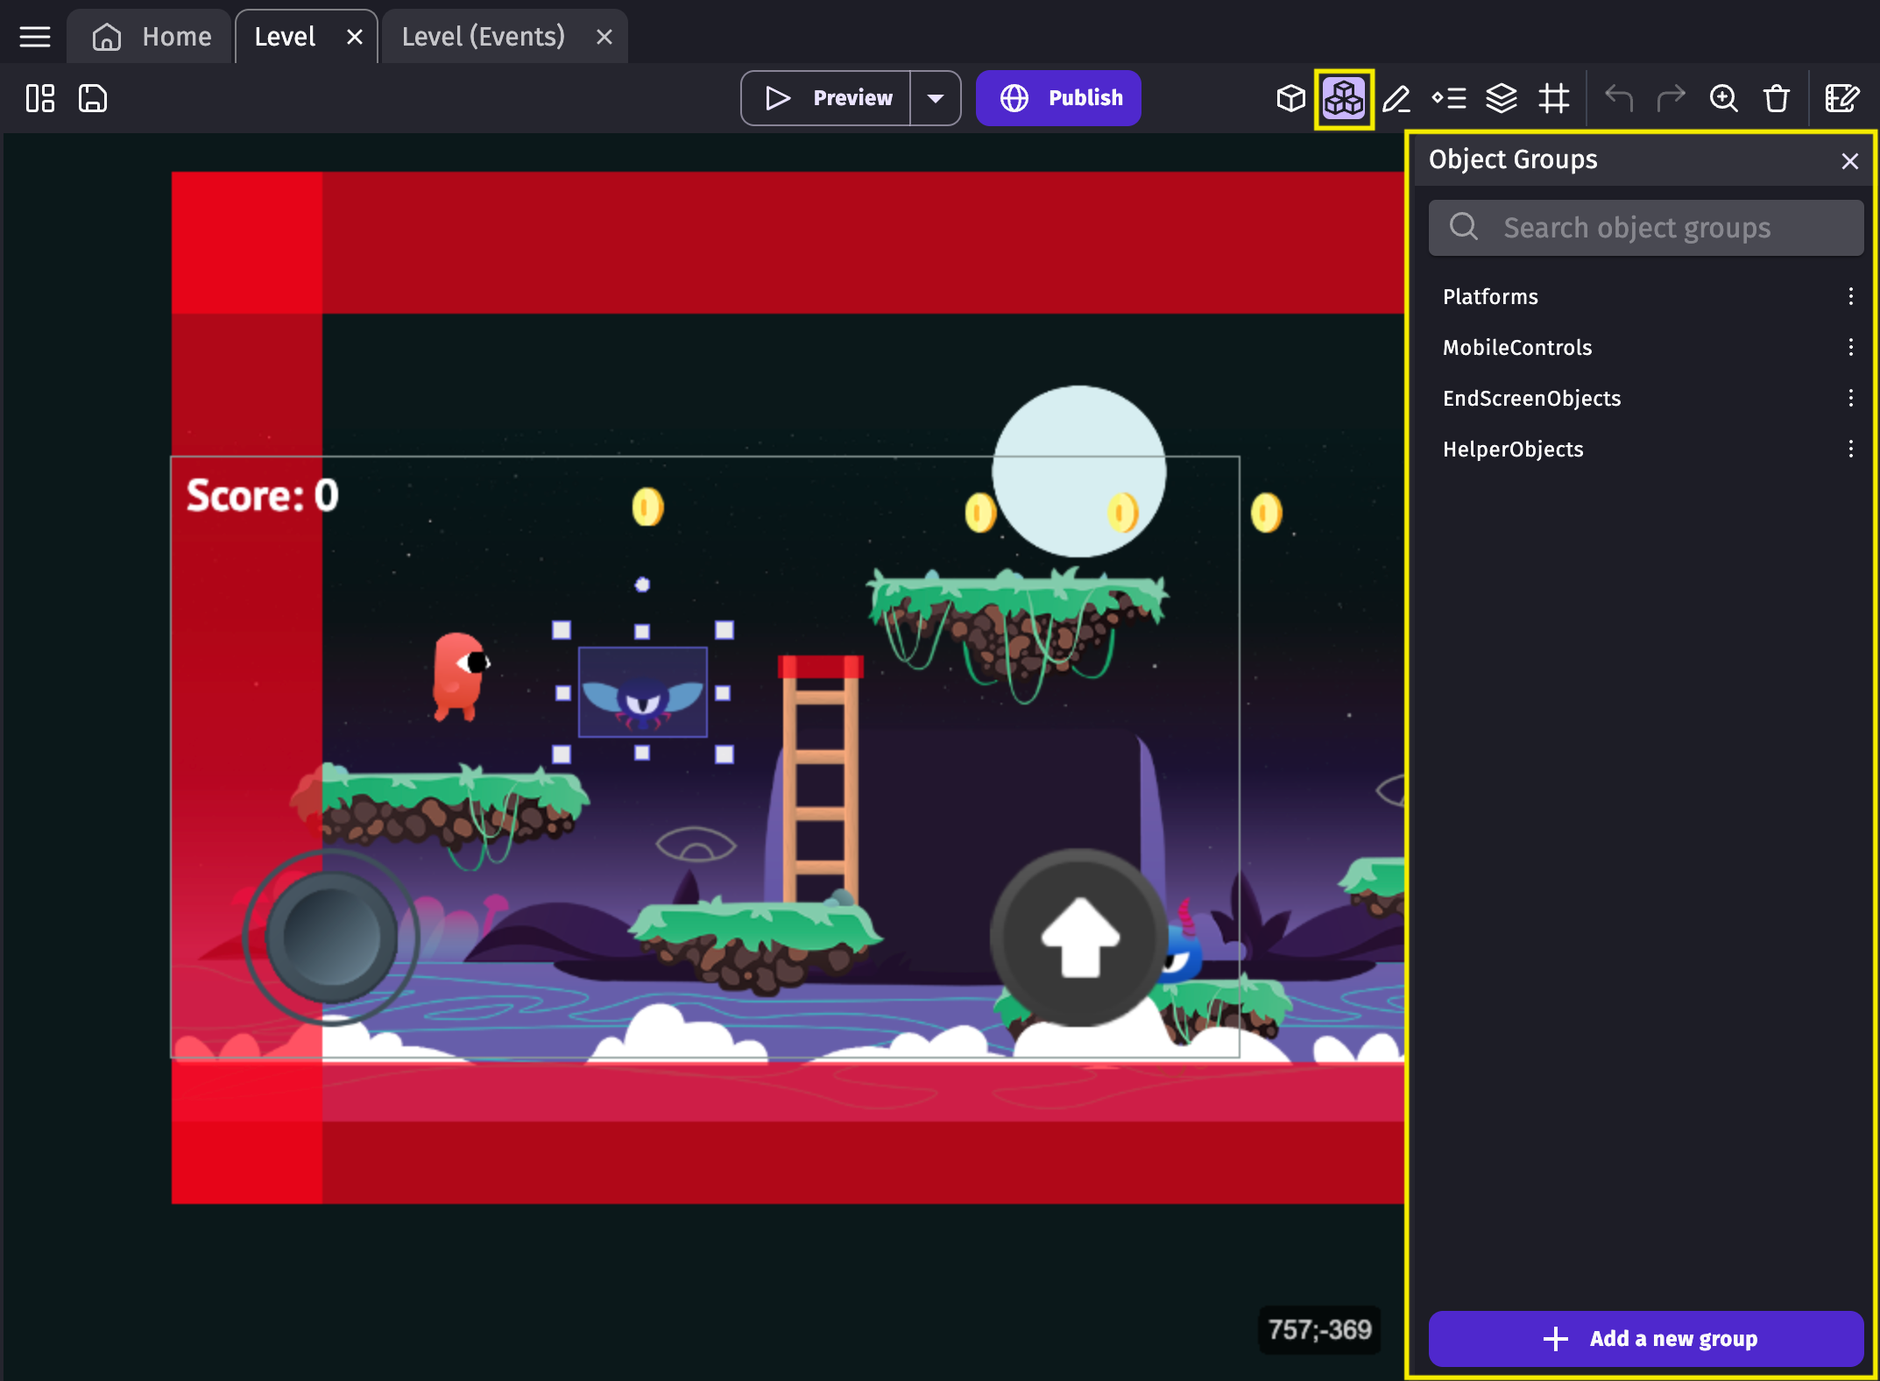
Objects Groups panel
In the Objects Groups panel, you can find the list of groups of objects that are present in the scene. Object groups contain objects and can be used in events to refer to multiple objects, using a single event.

Slide 9
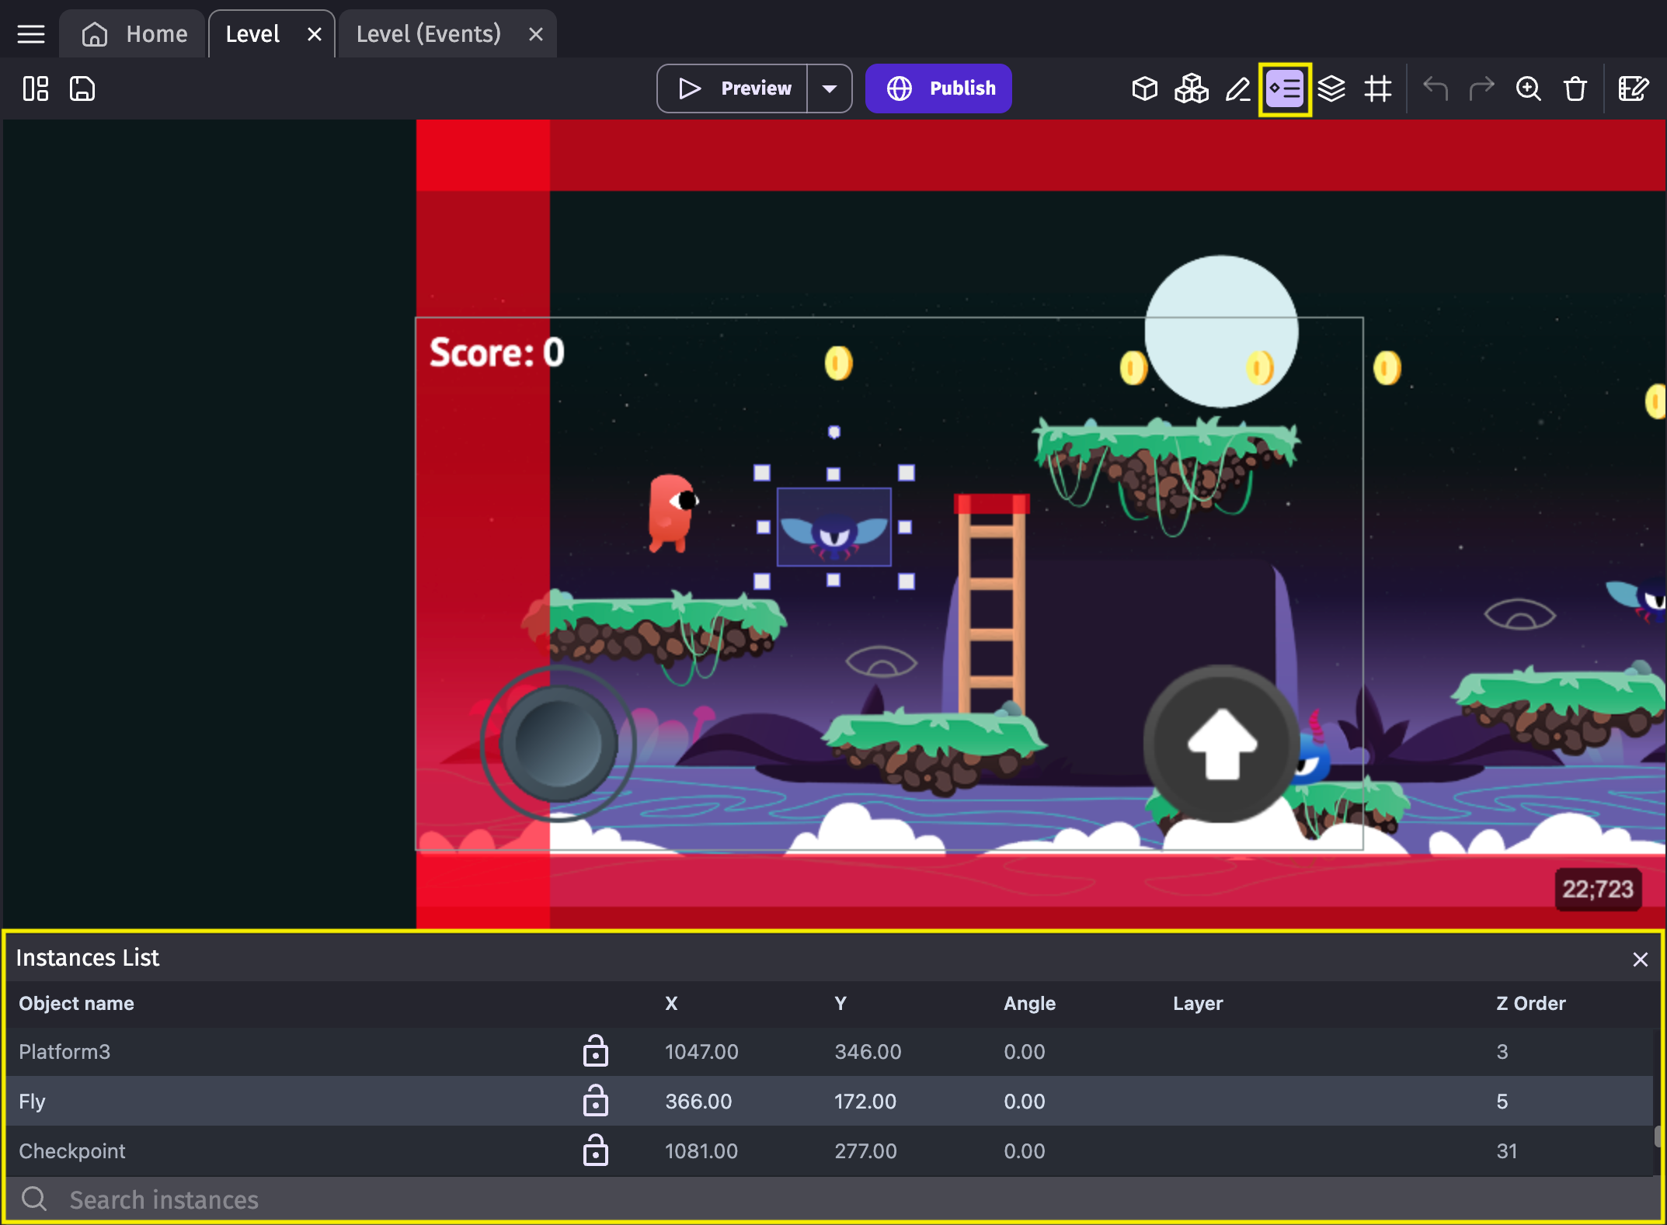
Instances panel
The instances panel displays the list of all of an object's instances living in the scene. It can be used to quickly select any instance. In the list, you can see the position, angle, layer and Z order in the scene of any instance.

Slide 10
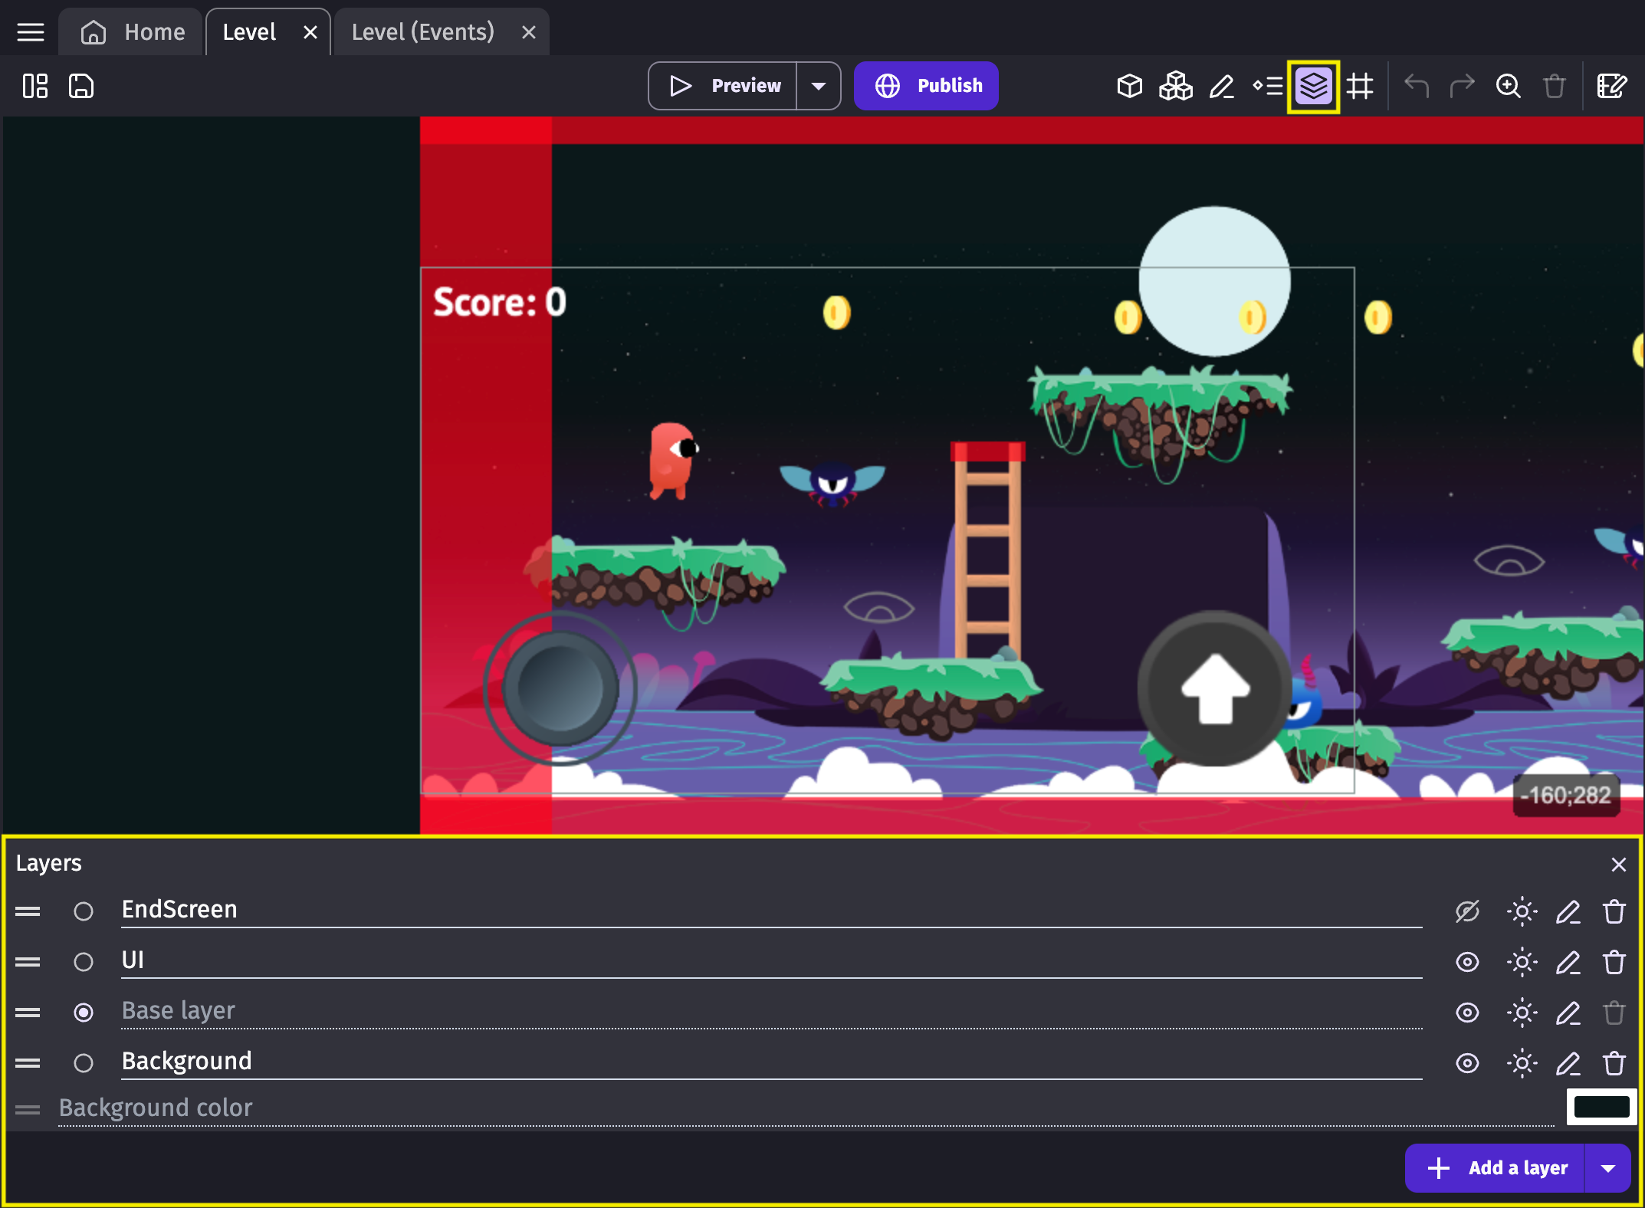
Layers panel
A layer acts as a virtual container for objects displayed on the screen. By default, objects are drawn on the “base layer”, but scenes can have multiple layers. For example, it is common for a "UI" layer to display controls and text, while another layer could be used for the background.

Slide 11
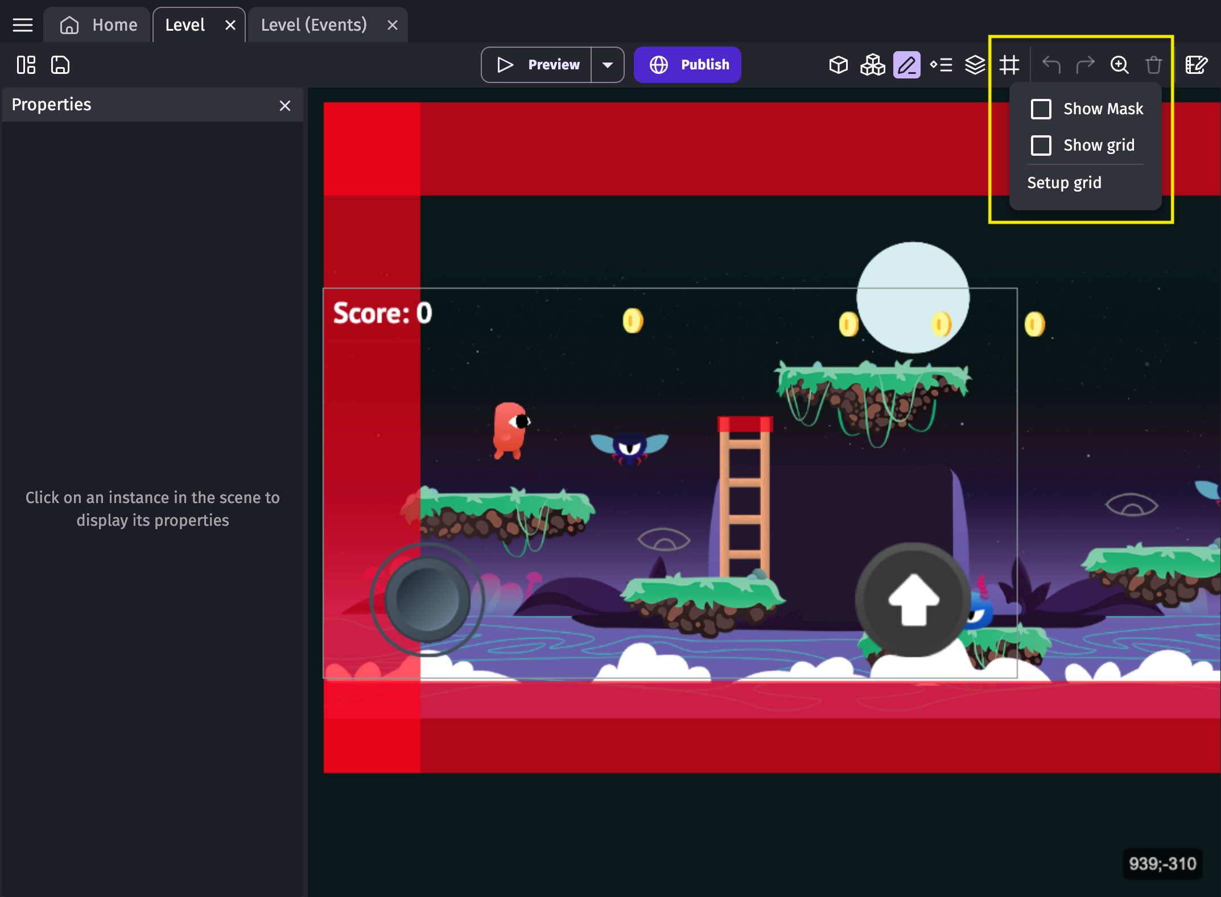
Toggle/Edit grid
By clicking the grid button in the toolbar, you get multiple options:
Show mask: this option displays or
hides a black border on the scene. It represents the size of the game window.
Show grid: this option turns the grid
off or on within the scene editor. Having
a grid is useful when we need to place objects accurately.
Setup grid: this option opens a window
that allows you to set up the size and position of the grid.

Slide 12
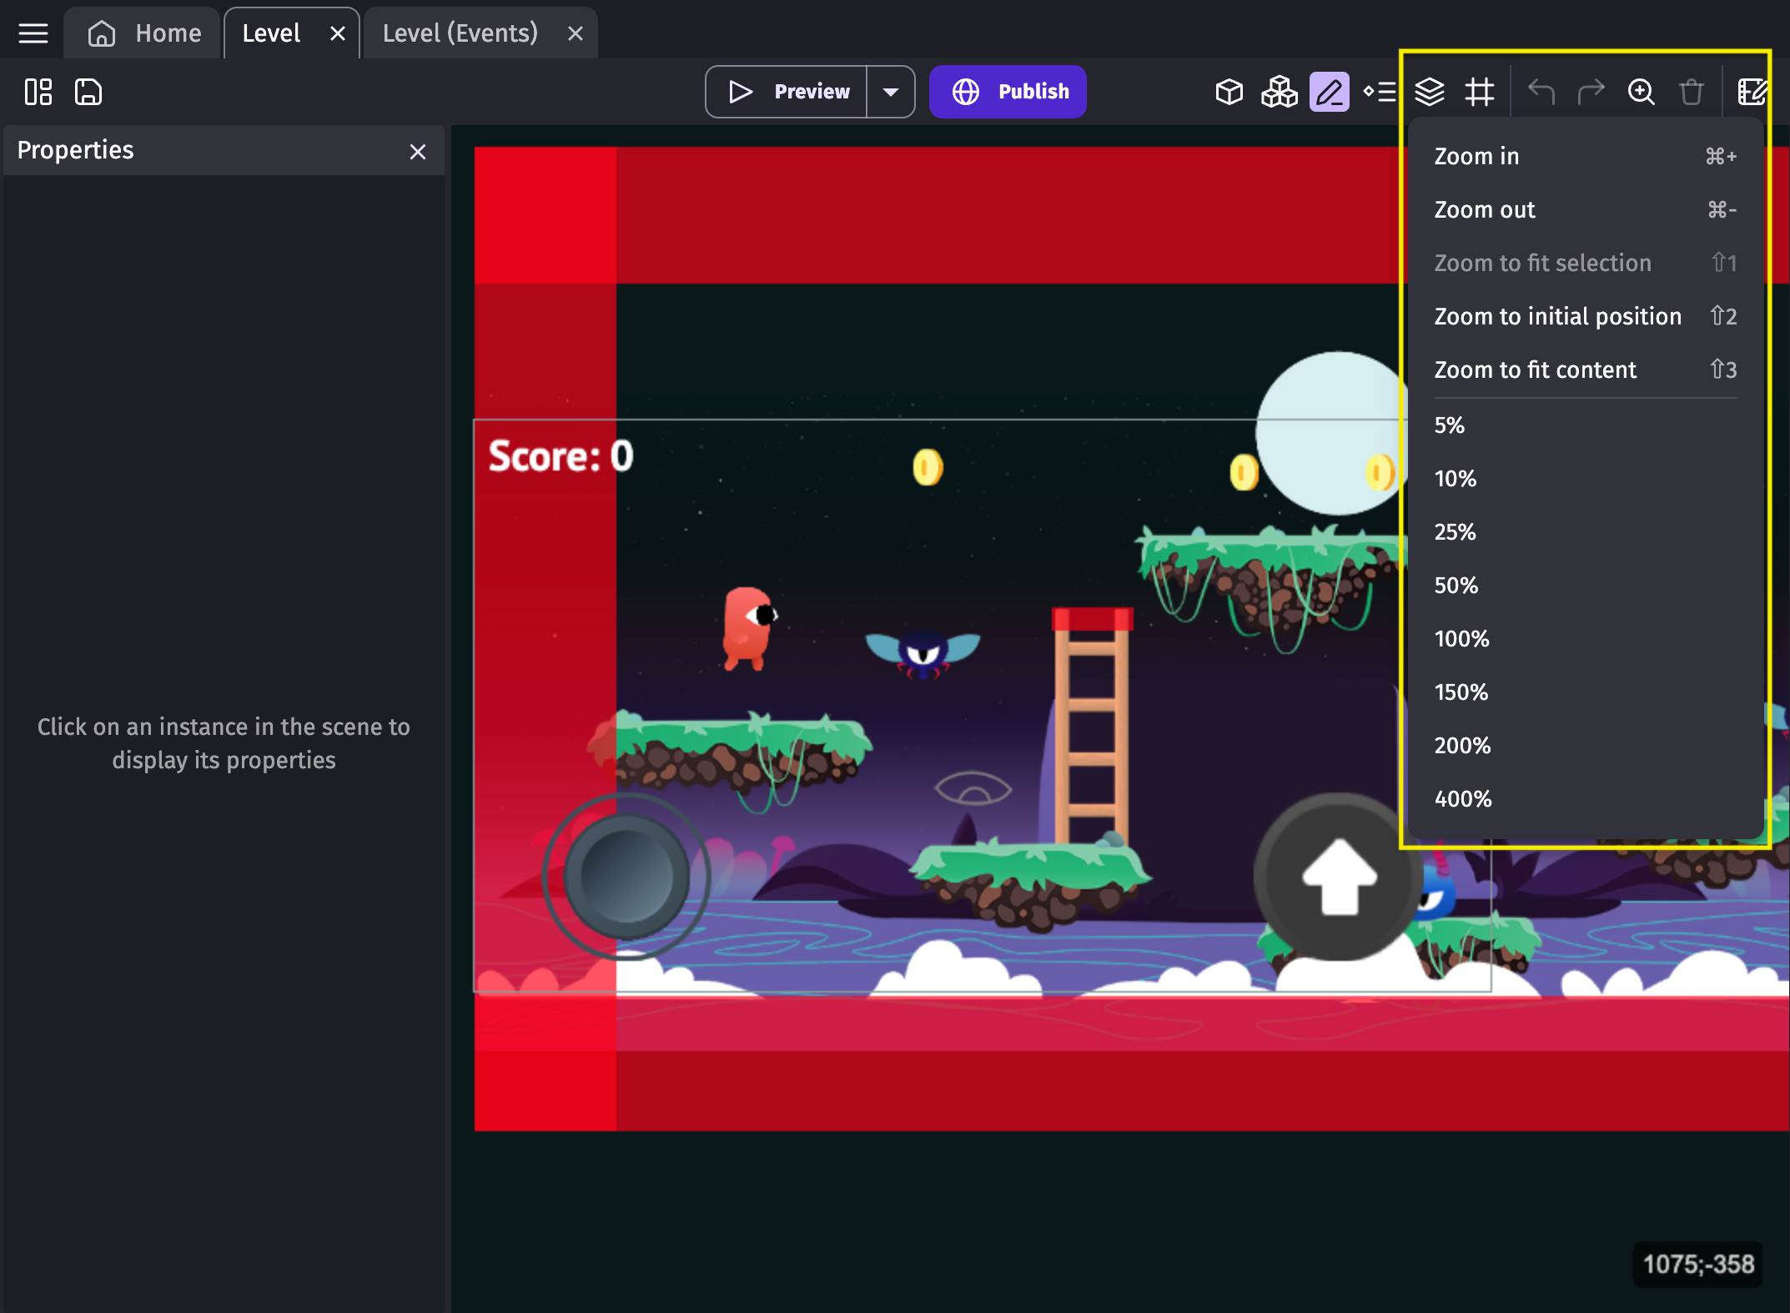
Change editor zoom
By clicking on the zoom button, you can change the zoom level inside the scene editor.

Slide 13
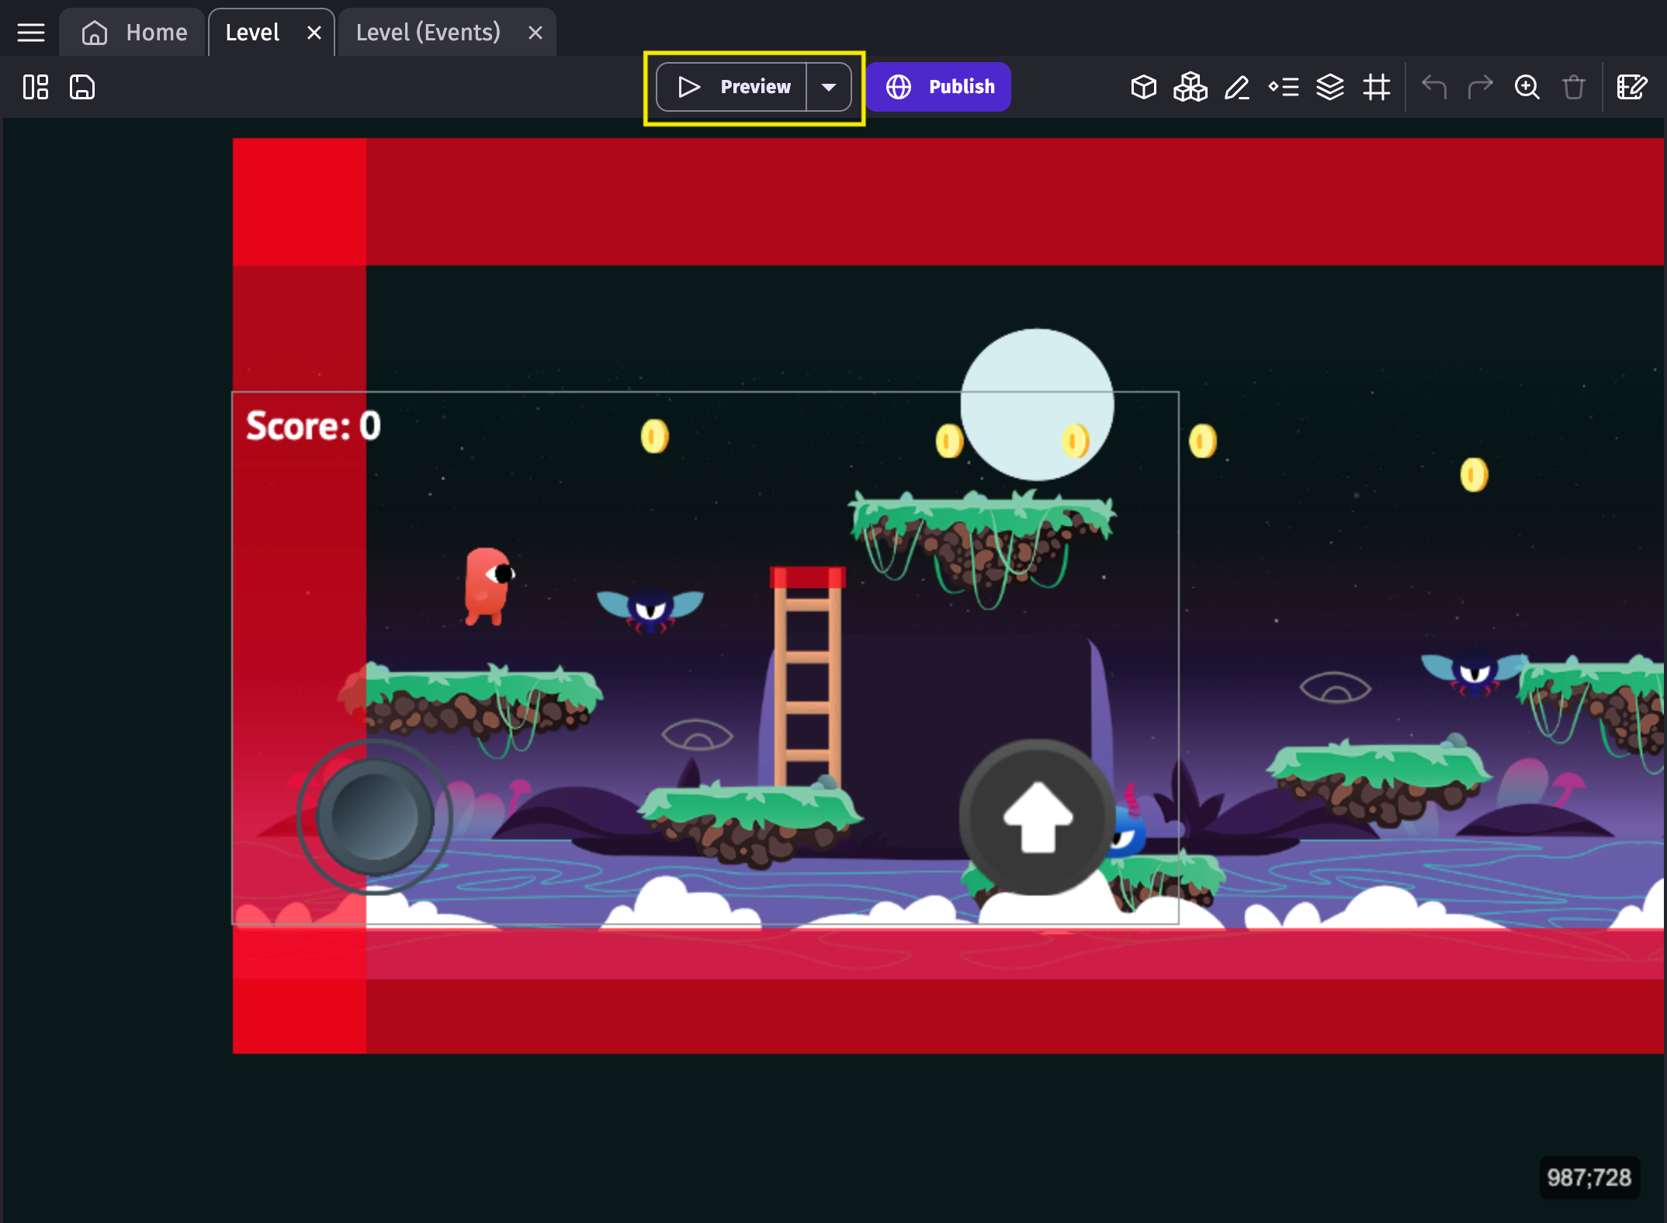
Launch a preview of the scene
By clicking on the "Preview" button, you can launch a preview of your game.
The preview will open in a
separate window.

Slide 14
Player movement and uploading your own assets (walk, run, jump, idle)
Here's a step-by-step guide on how to implement player movement and upload your own assets in GDevelop:
Step 1: Create a new project in GDevelop
Open GDevelop and click on Create a new project.
Choose a project name, resolution, and frame rate, and click Create.
Step 2: Create a player object
In the scene editor, click on Create an object and choose Sprite.
Name the object "Player" and set its position to (0, 0).
Click Create to create the player object.

Slide 15
Step 3: Add a behavior to the player object
In the object editor, click on Add a behavior and choose Platformer.
This behavior will allow the player object to move left, right, jump, and fall.
Step 4: Configure the platformer behavior
In the behavior editor, set the Movement speed to 100 and the Jump force to 200.
You can adjust these values to customize the player movement.
Step 5: Upload your own assets
In the asset manager, click on Upload an asset and choose the image file for the player's walk animation.
Repeat this step for the run, jump, and idle animations.
Make sure to upload the assets in the correct format (e.g. PNG or GIF) and resolution.

Slide 16
Step 6: Assign the assets to the player object
In the object editor, click on Edit animations.
In the animation editor, assign the uploaded assets to the corresponding animation states (e.g. walk, run, jump, idle).
You can adjust the animation speed and other settings to customize the animation.
Step 7: Add animation transitions
In the animation editor, click on Add a transition.
Set the transition from the Idle state to the Walk state when the player presses the left or right arrow key.
Repeat this step for the other animation transitions (e.g. walk to run, run to jump, etc.).
8: Test the player movement
Click on Preview to test the game in the browser.
Use the arrow keys to move the player object and see the animations in action

Slide 17
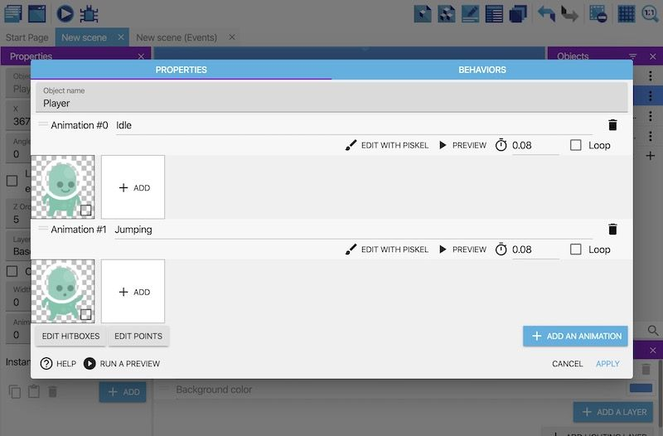
Animation in G develop
In GDevelop, animations are a way to display a sequence of images or frames to create the illusion of movement or action. Animations can be used to bring your game characters, objects, and scenes to life.
Step 1: Add a jumping animation to the player
In G Develop, you can add animations to an object and trigger those animations when something happens (such as when a player jumps).
Add the "Jumping" animation to the "Player" object
To add a jumping animation to the "Player" object:
In the Objects panel, right click the "Player" object.
Select Edit object.
Click Add an animation.
Assign a name of "Jumping" to the animation.
Click Add.
From the file chooser, select the "p1_jump.png" asset.

Slide 18
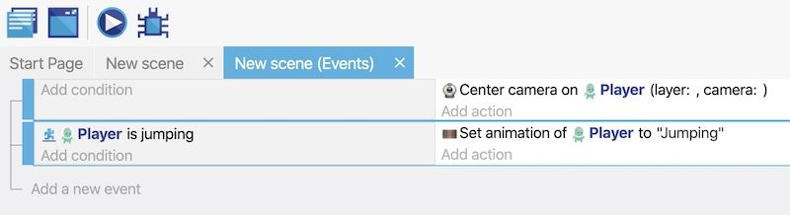
But while the animation is attached to the object, it won't play unless something triggers it.
Trigger the "Jumping" animation
To trigger the "Jumping" animation:
Switch to the Events editor
Create a new event.
Add the Is jumping condition to the "Player" object.
Add the Change the animation (by name) action to the event.
In the Animation name field, enter the name of the "Jumping" animation. You must wrap this name in double quotes (i.e. “Jumping”)
Click ok

Slide 19
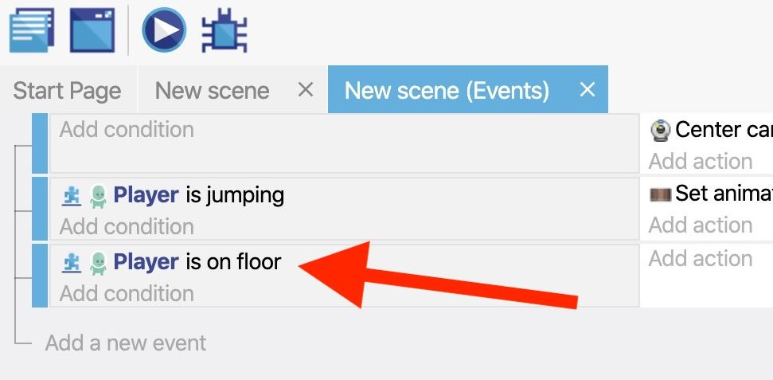
Step 2: Add an idle animation to the player
There's a problem with the jumping animation: it doesn't reset when the player has finished jumping. To fix this, trigger the "Idle" animation when the player returns to the platform.
Detect when the player is on the floor
G Develop refers to the surface of a platform as the floor.
To detect when an object is on the floor:
Create a new event.
Add the Is on floor
condition to the "Player" object.

Slide 20
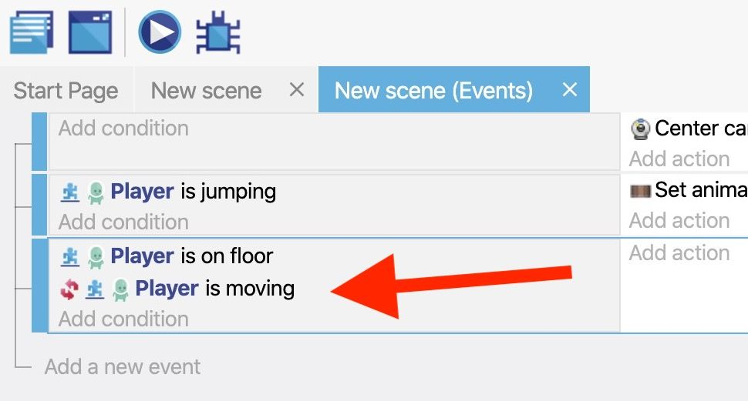
Detect when the player is not moving
It only makes sense to trigger the "Idle" animation when the player is still, since moving the player should trigger the "Running" animation (explained in the next step).
To detect when the player isn't moving:
Add the Is moving condition to the "Player" object.
Toggle the Invert condition option to the on position.
The Invert condition option inverts the way a condition works.
This means the Is moving condition becomes
the Is not moving condition.

Slide 21
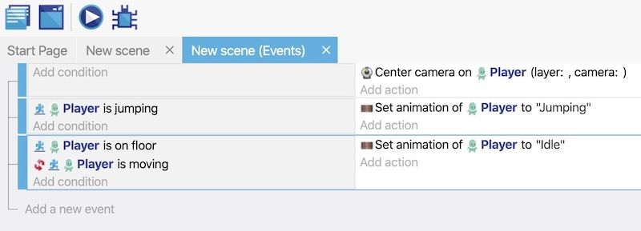
Trigger the "Idle" animation
When both of the previous conditions are met, trigger the object's "Idle" animation:
Add the Change the animation (by name) action.
In the Animation name field, enter the name of the "Idle" animation. You must wrap this name in double quotes(i.e. “Idle”)

Slide 22
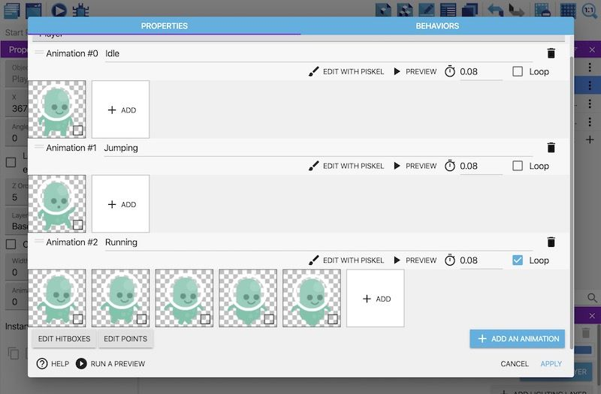
Step 3: Add a running animation to the player
Add the "Running" animation to the "Player" object
Add an animation named "Running" to the "Player" object.
From the file chooser, select all of the following assets:
p1_walk03.png
p1_walk04.png
p1_walk05.png
p1_walk06.png
p1_walk07.png
3. Enable the Loop option. When enabled,
the animation continually plays for as long as it’s
active (rather than playing once and stopping).
4. Click Apply.

Slide 23
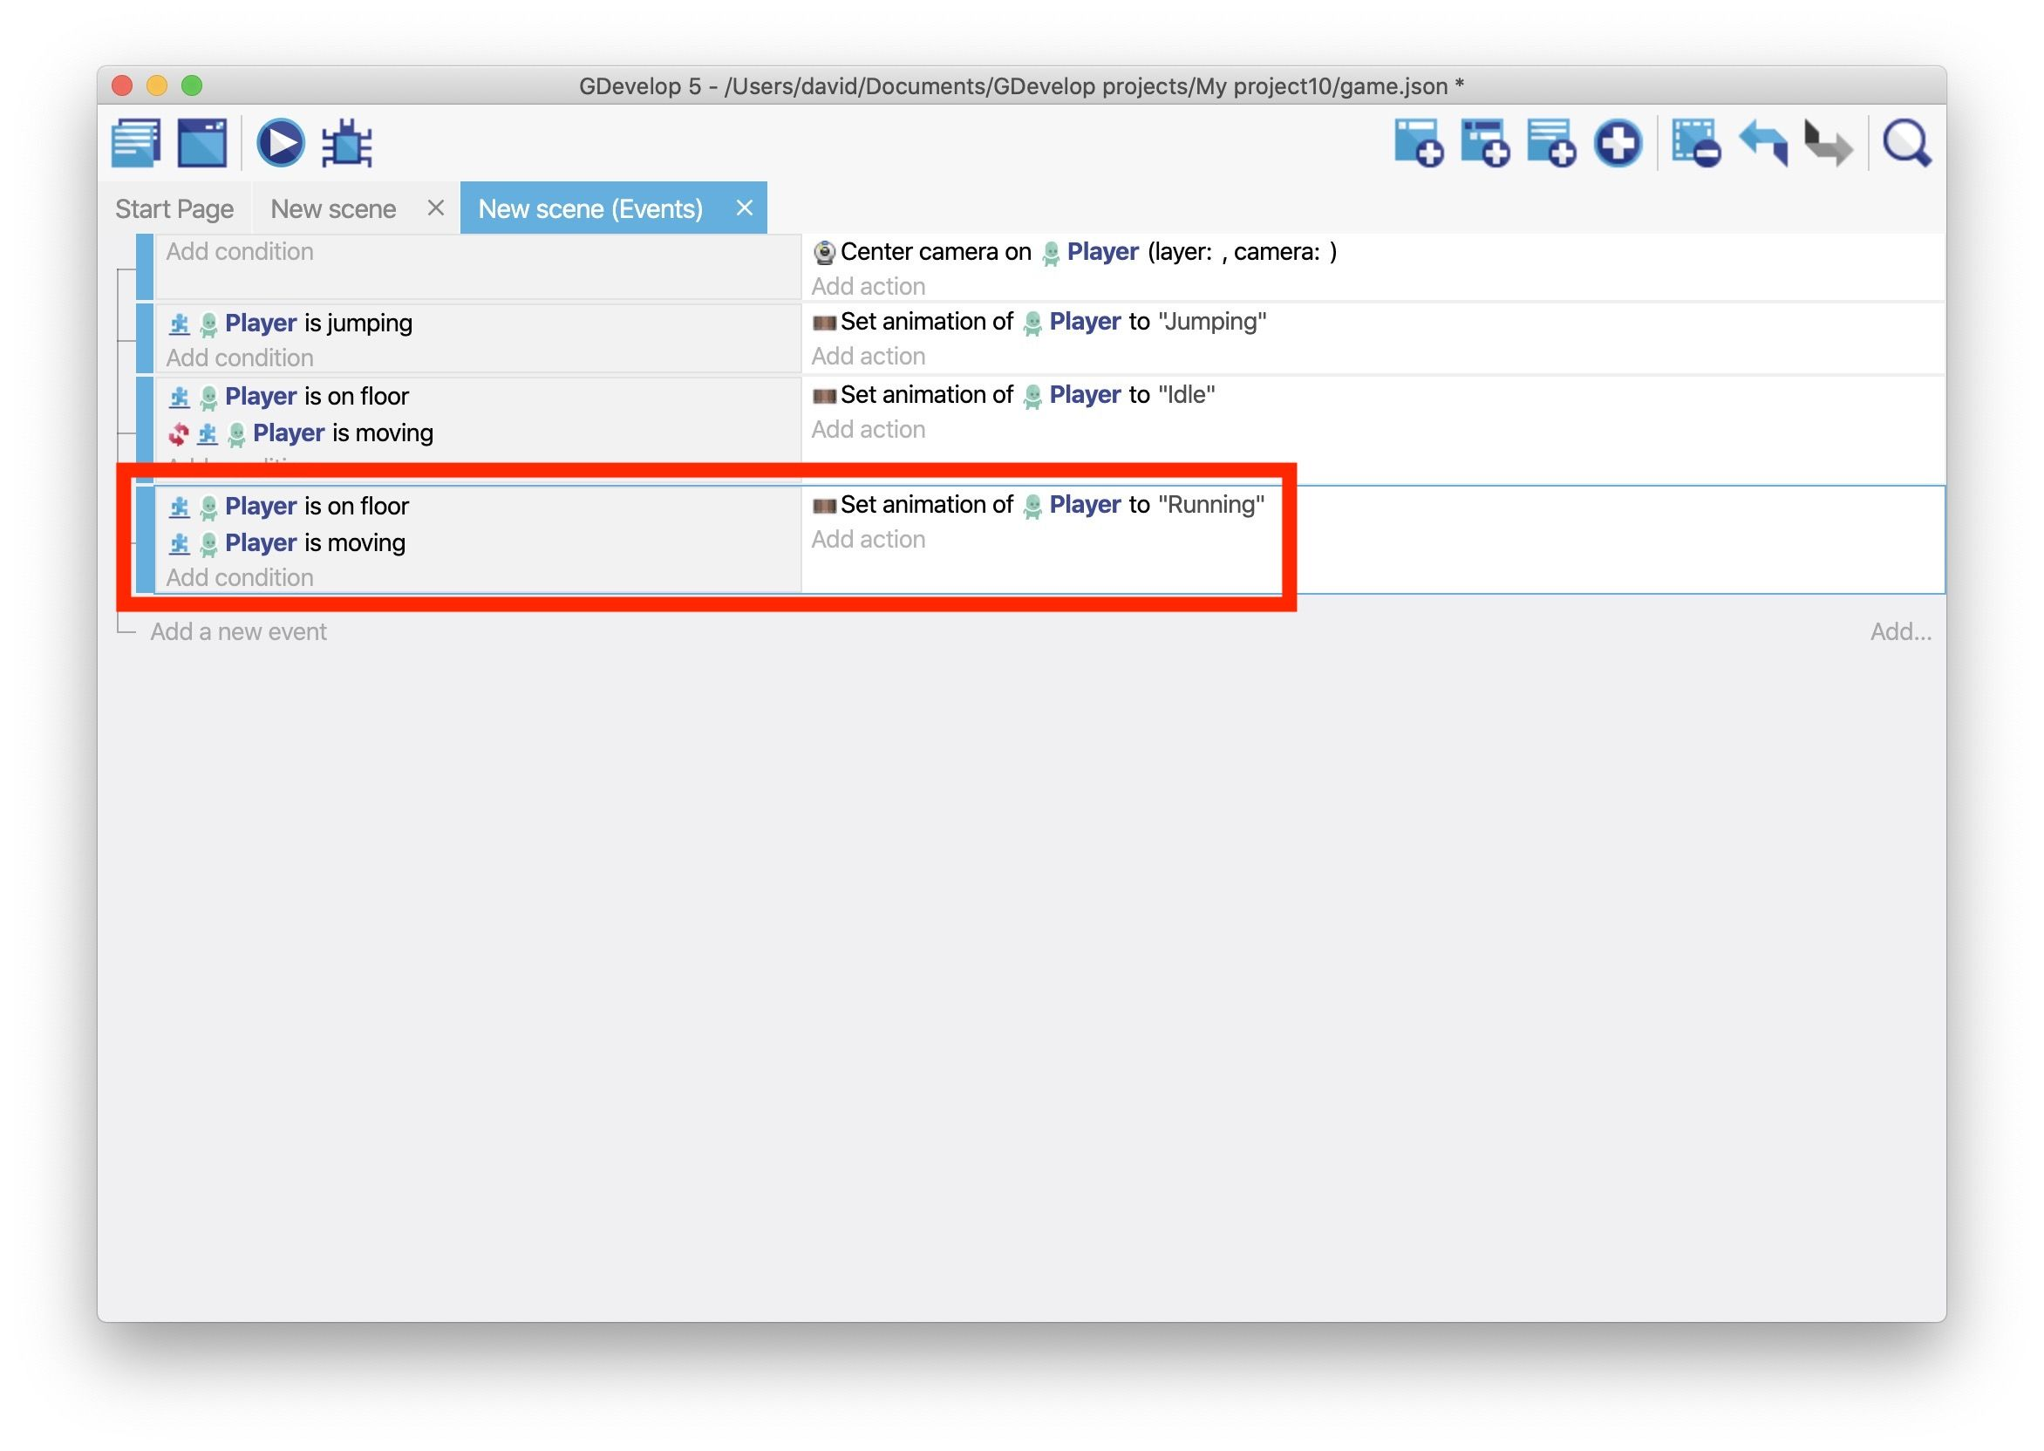
Trigger the "Running" animation
Create a new event.
Add the Is on floor condition to the "Player" object.
Add the Is moving condition to the "Player" object.
Add the Change the animation (by name) action to the event.
In the Animation name field, enter the name of the "Running" animation. You must wrap this name in double quotes(i.e. “Running”)
Click ok

Slide 24
Adding dialogue in G Develop
This extension adds functionality of a dialog box to your game. Add this to the sprite object that will be the background of the dialog box.
How to use:
You will need a background sprite, a character sprite, a BBText to display the name, a BBText to display the text, and a sprite for the icon to prompt the player for action.
Add the "Dialog Box" behavior to the background object.
Place each object in the scene.
Execute the "Setup Dialog Box" action only once in the event.
After that, execute the "Open Dialog Box" action, "Close Dialog Box" action, etc.
Behavior actions
Change Dialog Box contents Change the Name, Image, and Text in the Dialog Box.
Change Dialog Box Text Change the Dialog Box Text.

Slide 25
Change Dialog Box typing interval Changes the typing interval of the Dialog Box (in seconds).
Change Dialog Box typing sound Changes the typing sound effect of the Dialog Box (File name) (The audio file must be registered as a resource!).
Close Dialog Box Close the Dialog Box.
Open Dialog Box Open the Dialog Box.
Setup Dialog Box Setup the Dialog Box.
Skip Dialog Box typing Skip typing in the Dialog Box.
Behavior conditions
Number of times the Text in Dialog Box has changed Compare the number of times the Text in the Dialog Box has changed.
Dialog Box is close Dialog Box is close.
Dialog Box is open Dialog Box is open.
Dialog Box is typing Text in the Dialog Box is typing.

Slide 26
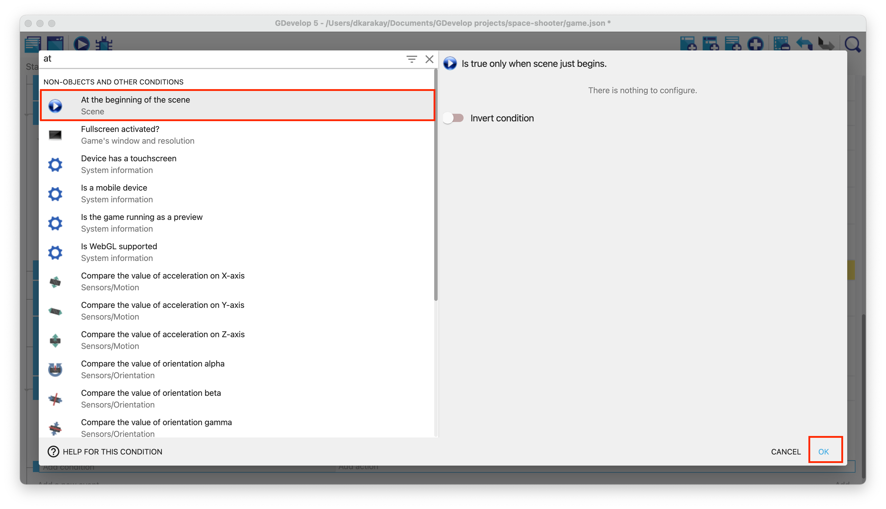
Adding sound effects gameplay-wise
Determine the beginning of the scene
Firstly, we will add soundtrack music to our game. This music will be played at the beginning of the game. Hence, we have to determine when the scene starts. We are using a built-in condition called "At the beginning of the scene." So, open the Events tab and add a new event.

Slide 27
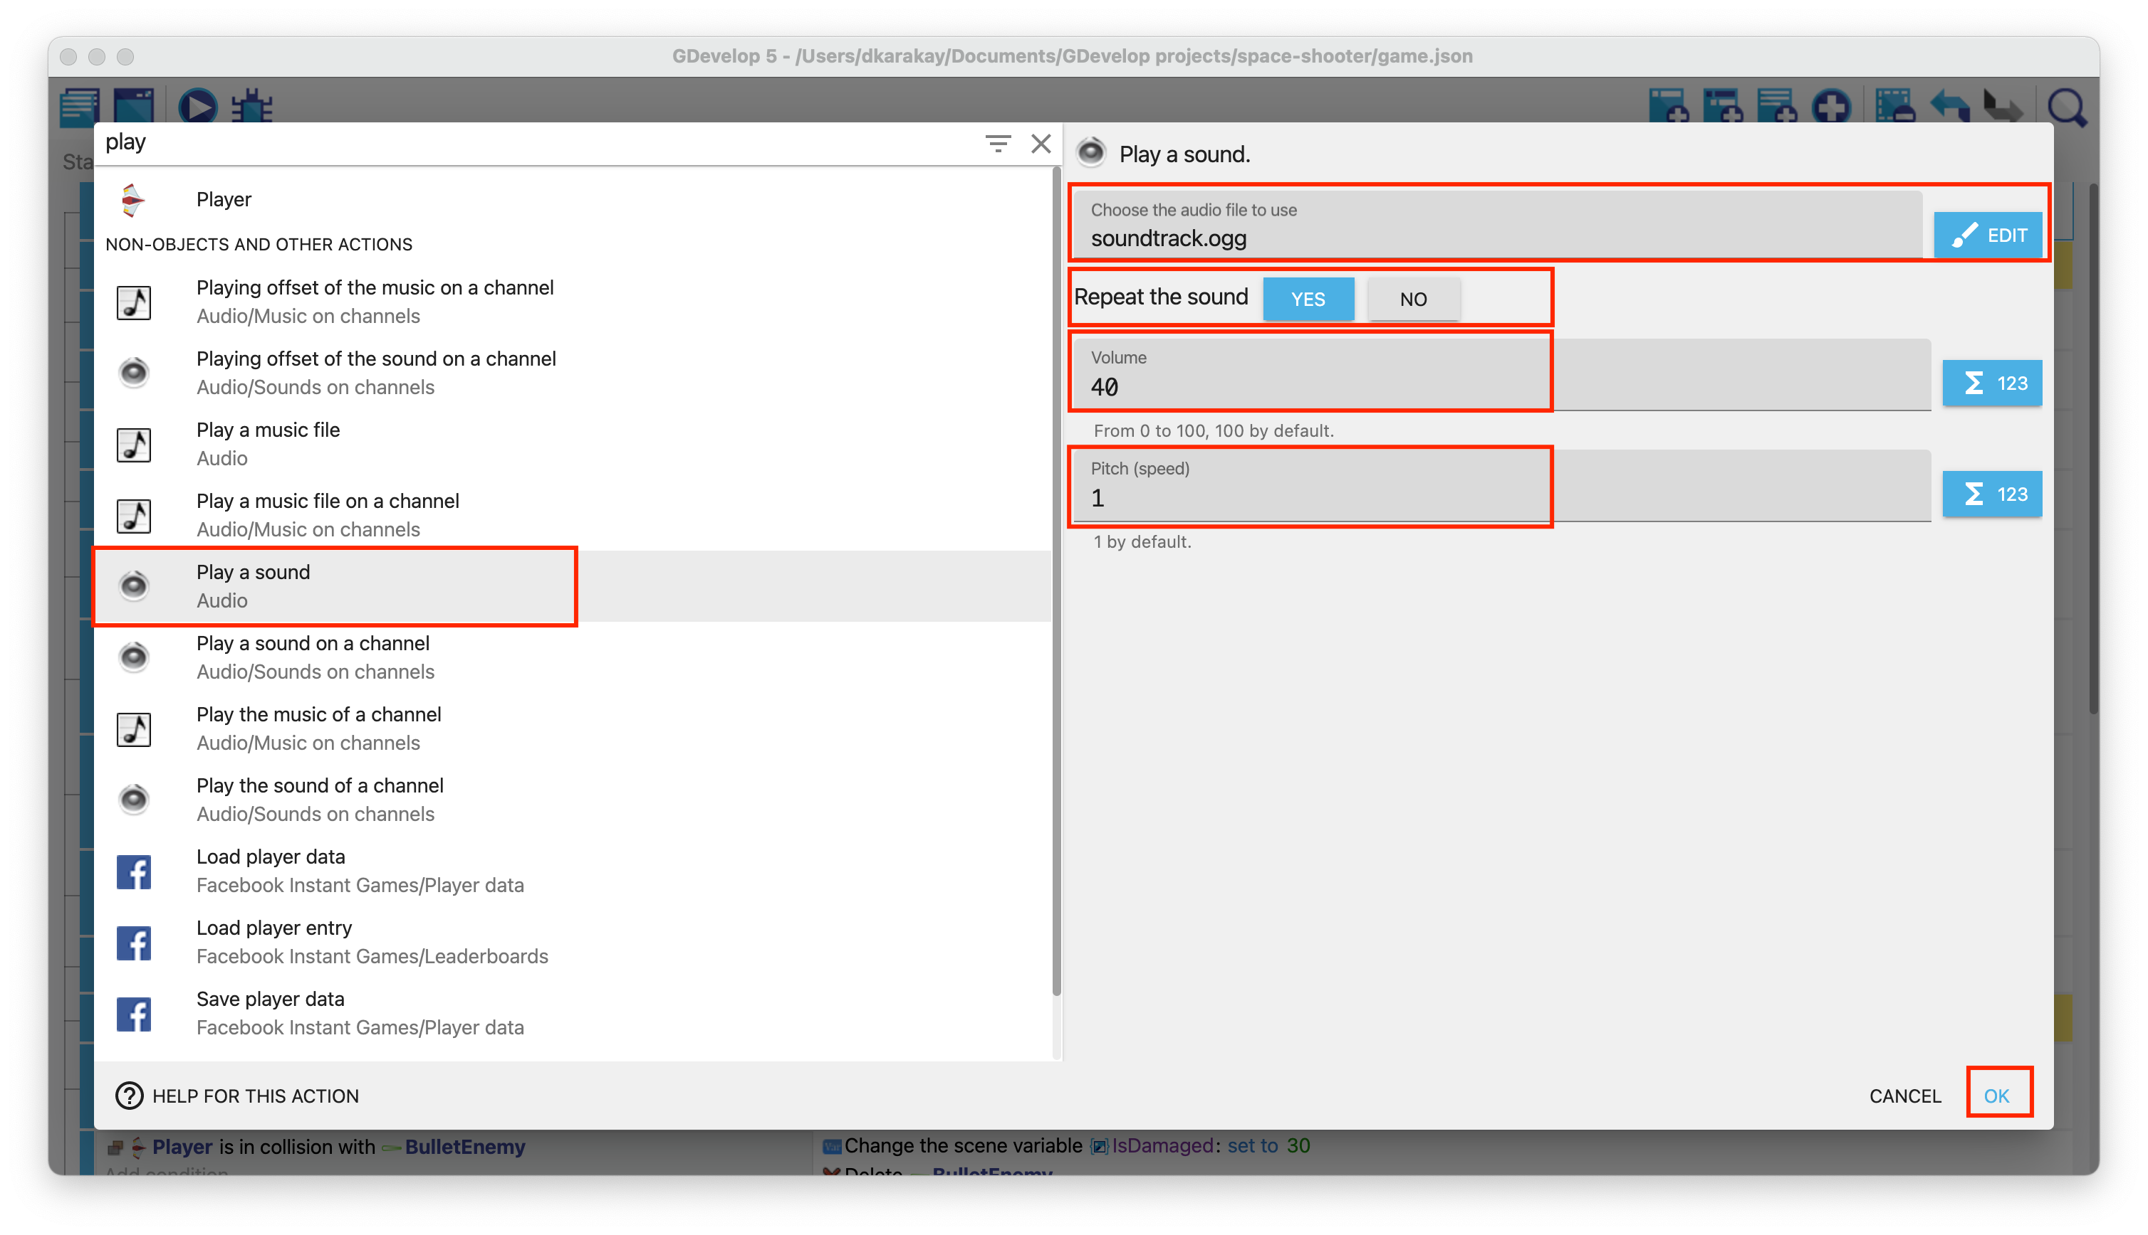
Playing sounds
Create a new action in the previous event. Type play on the search bar, and select Play sound. Add an audio file called "soundtrack.ogg" from the assets folder. Set the volume 40, and enter 1 as the pitch value.

Slide 28

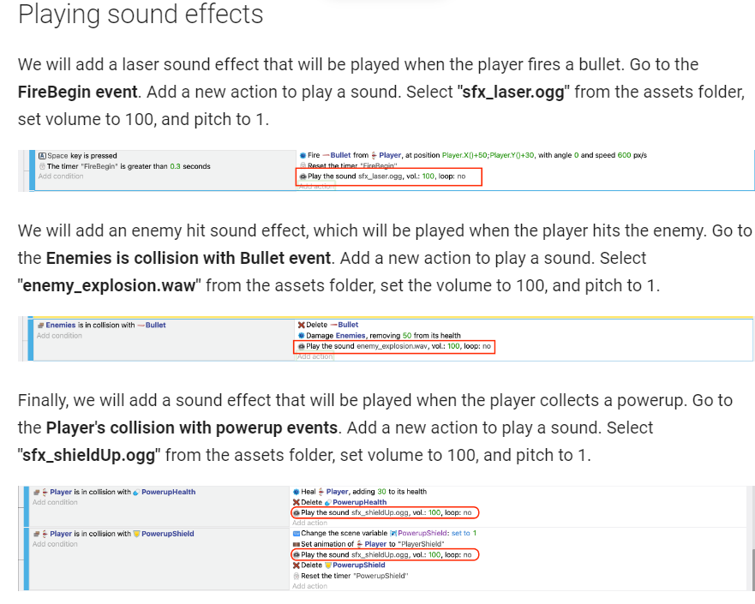
Then, you should see:

Slide 29
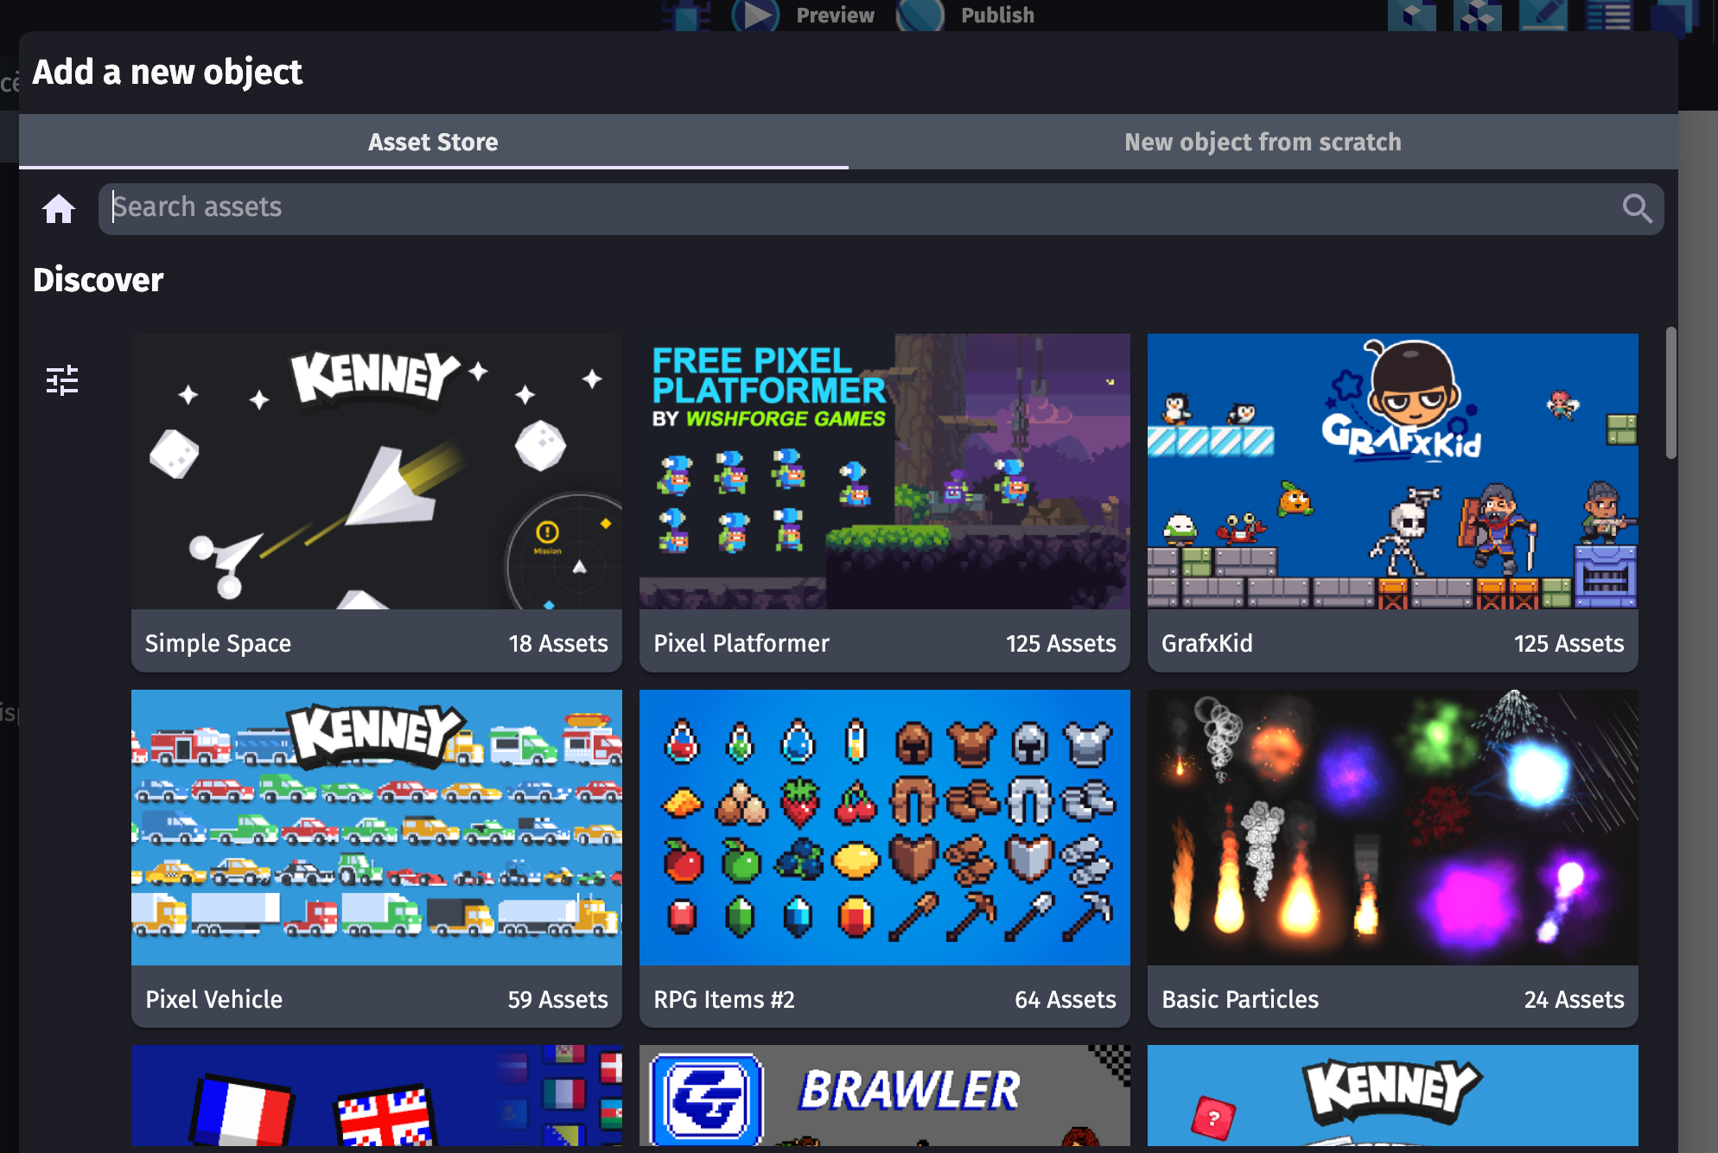
Importing assets and creating scenes
G Develop has its own built-in asset store, allowing game creators to access game art directly on the app. By providing easy-to-use and high-quality assets we're allowing creators to get a head start on their video game creation journey.

Slide 30
Importing Assets
G Develop makes it straightforward to incorporate your game's visual and audio elements. Here's a basic guide:
Organize Your Assets: Before importing, structure your assets in a clear folder hierarchy. This helps in managing your project efficiently.
Access the Resources Tab: In G Develop, navigate to the "Resources" tab.
Import Images: Click the "Images" section, then "Import images". Select the desired images from your computer.
Import Sounds and Music: Similarly, use the "Sounds" and "Music" sections to import audio files.
Create Animations: For animated characters or objects, use the "Animations" section. Import the individual frames as images and create animation sequences
Creating Scenes
Scenes in G Develop are where you design the layout and interactions of your game.
Create a New Scene: In the "Scenes" tab, click "Create a new scene".
Add Background: Select a background image from your imported resources and drag it onto the scene.
Insert Objects: Add objects (like characters, enemies, platforms) from the object library. You can also create custom objects.
Set Object Properties: Customize object properties, including position, size, image, and behaviors.
Create Events: Use the event editor to define object interactions, game logic, and player input.

Slide 31
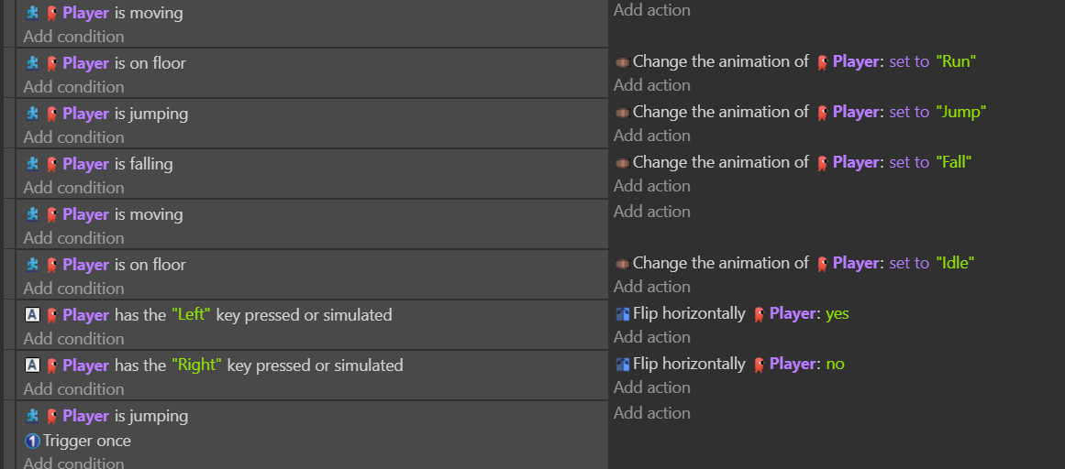
Making the player look in both directions

Slide 32
Thank you !

